Slide 1
Quantum bucket
An experimental idea evolves from qpong

Slide 2
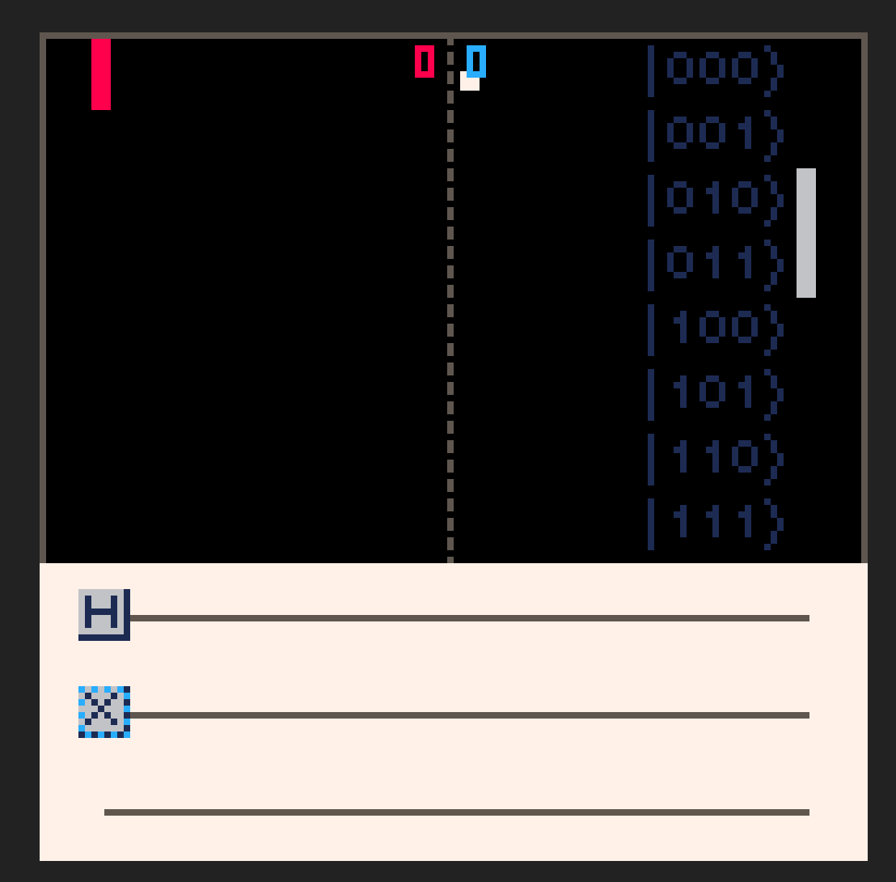
The legendary qpong
Developed by Junye Huang et. al in 2019.
Move paddle to location represented by states which given by quantum circuits after user assemble the quantum gates.
Purpose?
Fun.
Train user to create quantum circuit matching the given state distribution.
How can we make it MORE fun?

Slide 3
What can we do to MAKE IT better
Conclusion after playing (what can be better):
Can potentially win by using X gate along (just mapping out the binary states)
It is challenging, but not exactly in a quantum way.
There is no difference in terms of difficulties as games played out.
Can we add some sense of competition?

Slide 4
proposal
Potential solutions:
Need to force user to use other quantum gates. The number of target states should be more than one.
UI should be classically friendly
And the difficulties should come from quantum.
Seek for competition.
Proposal:
Asking user to catch more than one “ball”.
Let user can easily assemble binary state with X gate along (classically simple).
Force user to assemble circuit that can form superposition while limit the use of gates.
High score system.

Slide 5
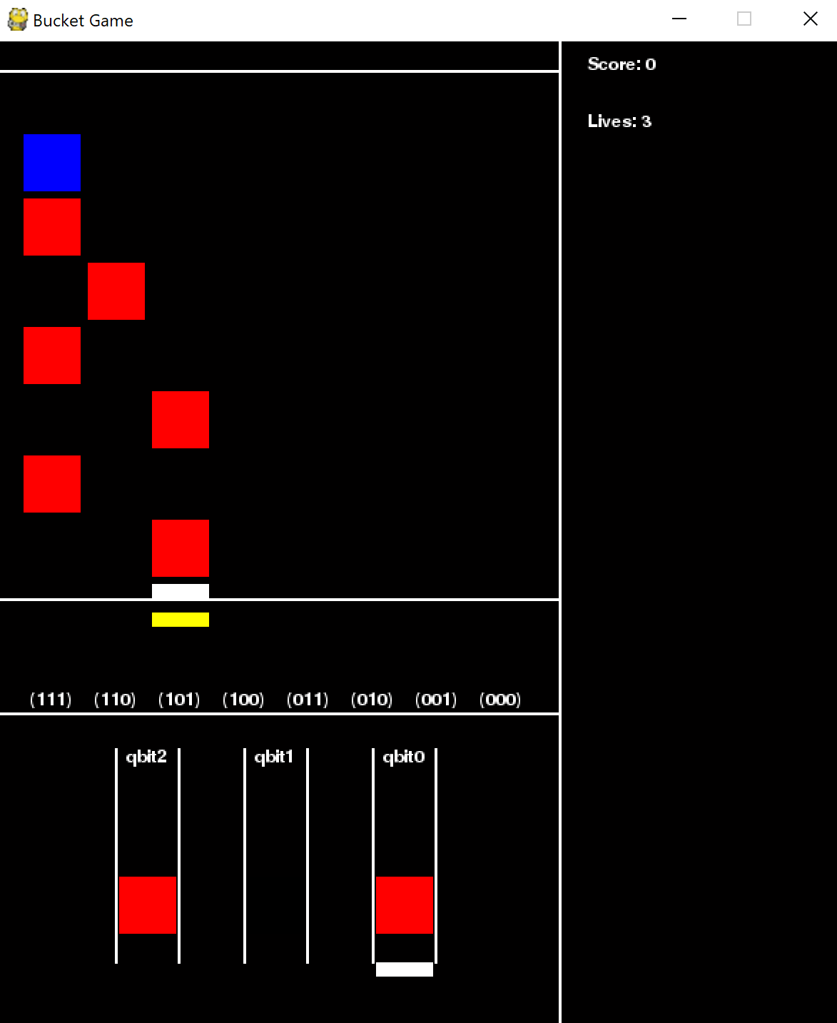
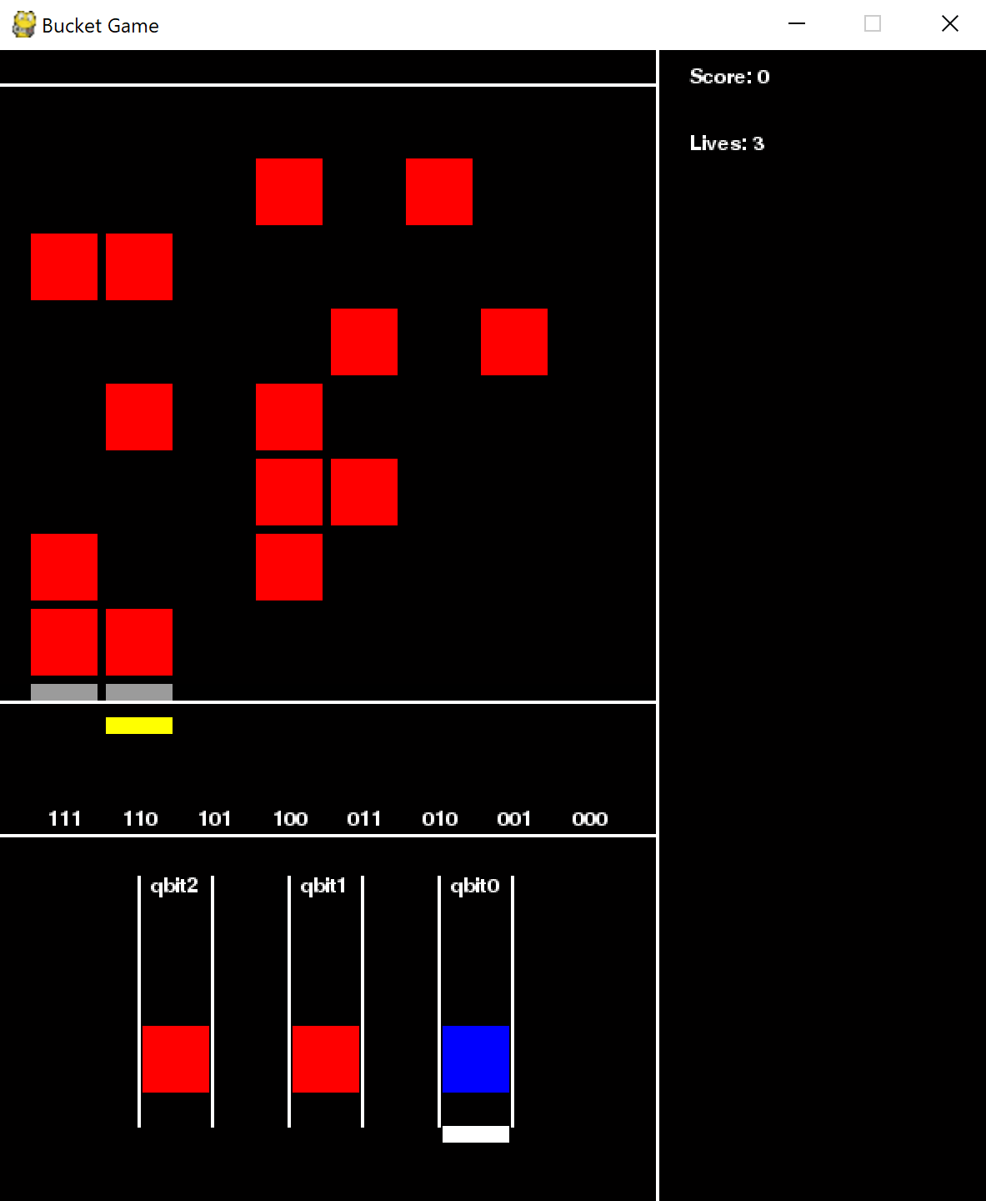
Asking user to catch more than one “ball”
The winning criteria is to “catch” blocks.
User has limited stocks on the amount of gates to assemble the circuit and move the paddle.
The blocks award user with number of gates so user can continue playing the game. (red: X, blue: H) User will be lightly punished by reducing stocks if missed.
Game over when user has no gates at his/her disposal.
The difficulties can be increased in below ways:
Number of blocks in each row.
How fast the blocks drop (different color can be dropping with different speed)
Fine tune the ratio between rewarding gates (budge control)

Slide 6
Let user easily assemble binary state with X gate along
Using binary conversion serves as the entry level training.
Designed to be simple so user can familiar themselves with the controls and UI.

Slide 7
Force user to assemble circuit that can form superposition while limit the use of gates
Invite “classical punishment factor” to force user to use quantum gates.
In this example, if user move paddle to 110 and missed the block at 111, we want to punish the user. Introduce a factor multiplied to the final reward, and set this factor to 0 if: one term in the inner products (|110>_{user} \dot (|111>+|110>)_{block}) is close to 0.
In this case, user will be wasting the block by using X gate along.

Slide 8
Seek for competition
High score system to provide a sense of competition.
Introduce different color of blocks with more features such as CX (Bell states), Noise specific function lasts one row (creating noise in qubits etc)
PvP system so user can “interfere” with each other.

